Slide 1
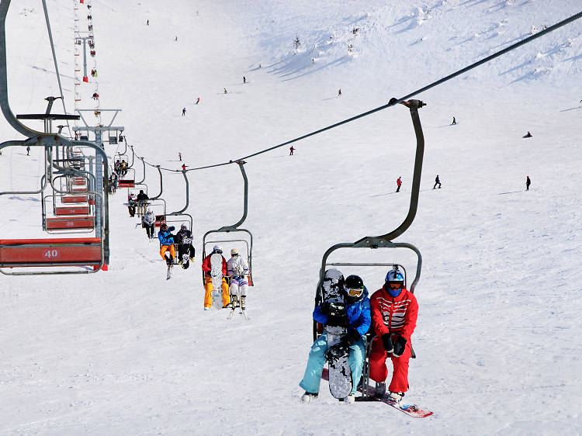
Big Mountain Resort Price Analysis
Submitted by: Aditi Gupta

Slide 2
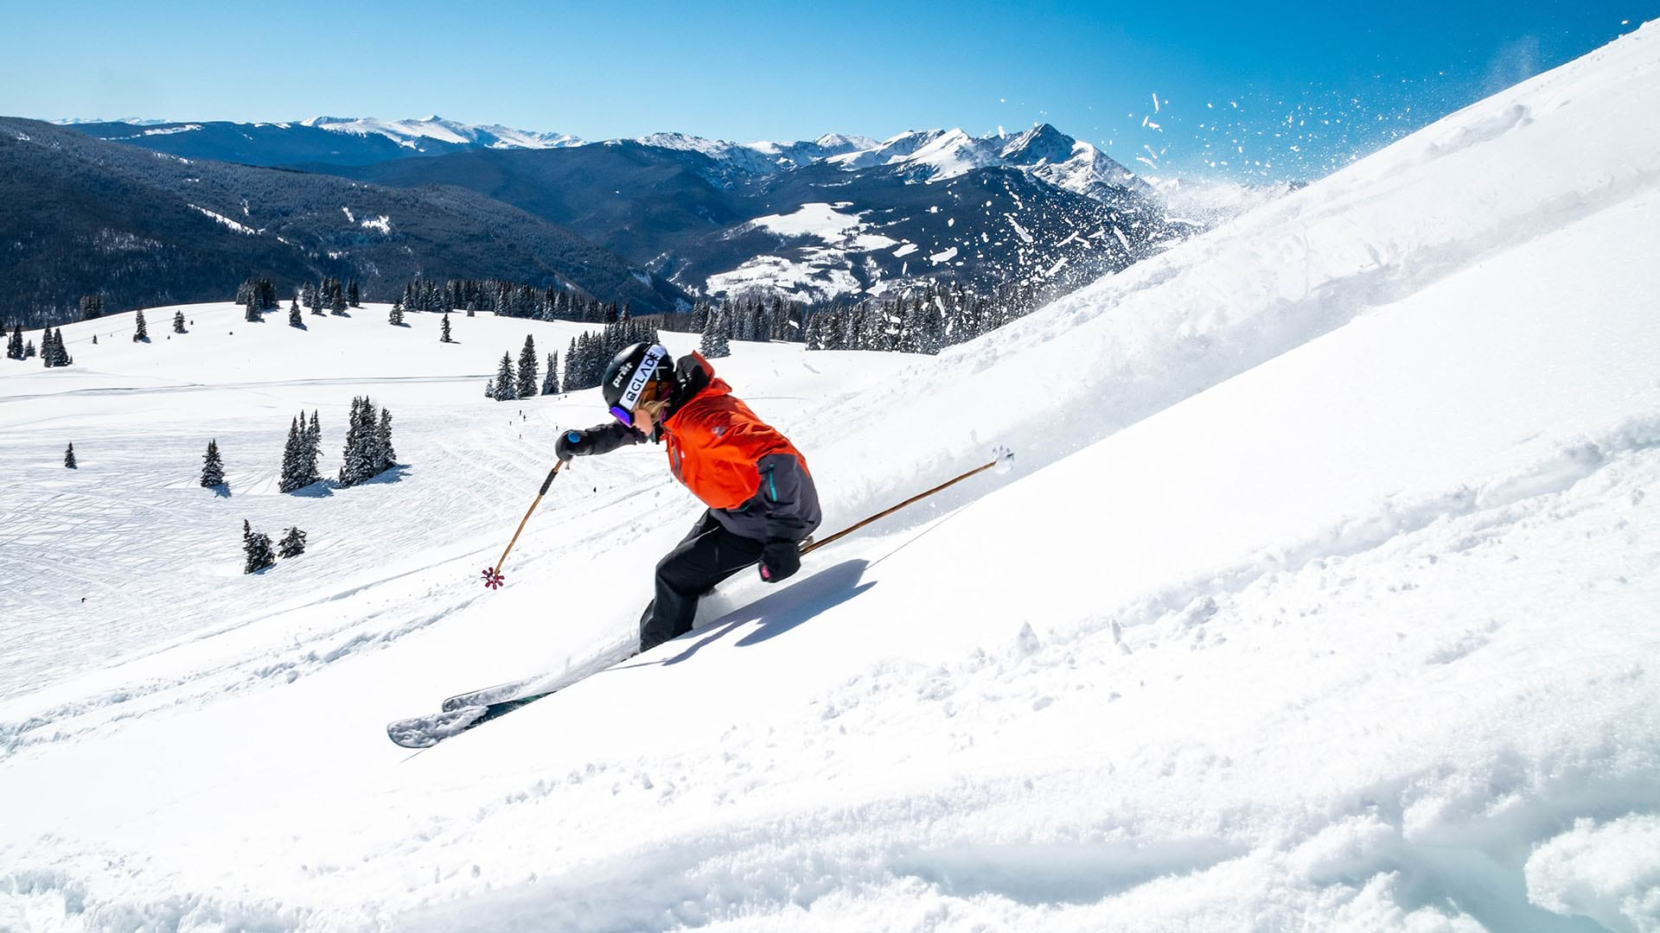
Problem
New chair lift increases distribution of visitors throughout the resort
Adds an additional $1.54 million in operation costs
Current Ticket Price: $81.00
How do we increase revenue and stay competitive for this upcoming season?

Slide 3
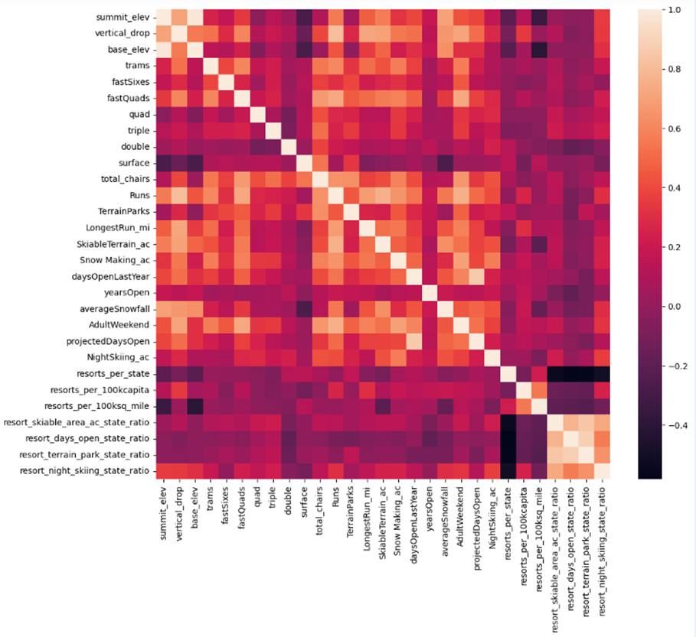
Key Findings
Four features have a strong positive correlation with ticket pricing:
fastQuads
SnowMaking_Ac
Runs
Night skiing ratio
Random Forest Model price: $95.87
Big Mountain Resort has significant enough facilities to justify this cost.

Slide 4
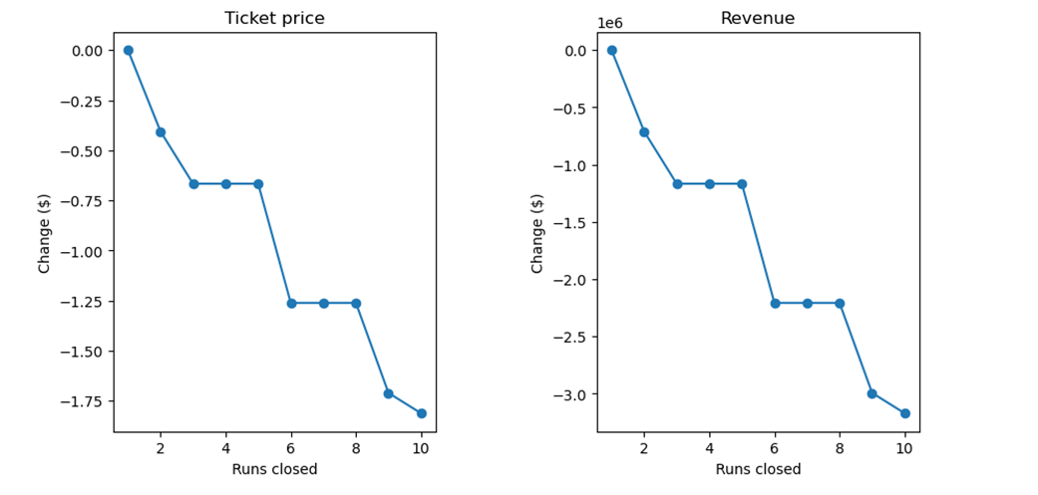
Model and Analysis
The resort can close up to 6 runs each day without a large drop in revenue.

Slide 5
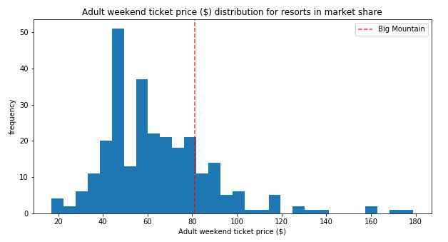
Model and Analysis Contd..
Big Mountain Resort ranks in the top quartile in seven of the eight most important qualities
Total Area of Snow Makers
Vertical Drop
Total Number of Chairs
Fast Quads
Total Number of Runs
Longest Run
Skiable Terrain Area
Raising the price would keep us around the same region in this distribution.

Slide 6
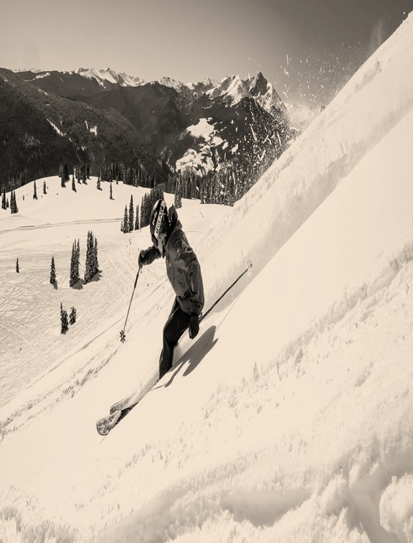
Recommendation
Raise ticket prices to $89.99
Have 4-6 runs closed each day to save on operation costs
Increase vertical drop by lowering a run 150ft, Install one additional chair lift, Add one additional run.
The model predicts that this could justify a $2 increase in ticket price, which would increase revenue by $3.47M

Slide 7
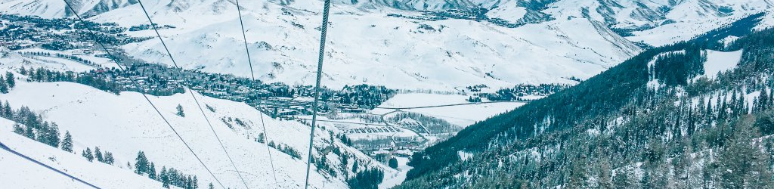
Conclusion
Big Mountain Resort is a high-end resort with many significant amenities and attractions to offer.
You can justify raising the cost if you continue offering high quality amenities, like the new chair lift, to your customers.
There is plenty of room to grow revenue and cover the additional operation costs. Any of these recommendations should keep Big Mountain Resort open for many years to come

